Slide 1
Regional ASMC PDI
Air Force Special Operations Command
OUSD(C) Advancing Analytics (Advana)
Financial Management Analytics

Slide 2








Advana provides real business value to the Department of Defense
Customer-centric Design
Product design is driven by customer business and mission needs, based on customer input feedback at all organizational levels
Open Architecture with No Vendor Lock-in
Best of breed open source and COTS tools
are built on an open architecture, hosted on
AWS Cloud, with the ability to pull government,
public, and commercial data feeds
Government Owned and Secured
DoD accredited system which can serve as a
long-term steward of business, mission, and
crisis related analytics on NIPR and SIPR
Something for Everyone
Range of ready-built visualizations and self-service options makes Advana relevant and impactful for ALL DoD users – from senior and mid-level decision-makers to analysts, developers, and data scientists
Scaled Agile Flexibility
Program resources leverage Scaled Agile (SAFe)
methodology for planning and delivery, which allows
for collaboration across our team and our
customers as we iterate on solutions together
Single Source of Truth
Thousands of users have access to over 200
DoD data sources across business domains
(e.g., Personnel, Finance, Supply Chain)
Foundation Built Upon Audit
Improved Data Quality for Trusted Insights
Our platform began as the Universe of Transactions for purposes of financial statement audit, and grew from there. The same audit principles that instill trust in our data for purposes of better decision making are applied to everything we do as a platform. This foundation leads to better business and mission decisions and outcomes via the ability to improve data quality, ask better questions of our data, and in turn, support decision making that creates value for the warfighter

Slide 3
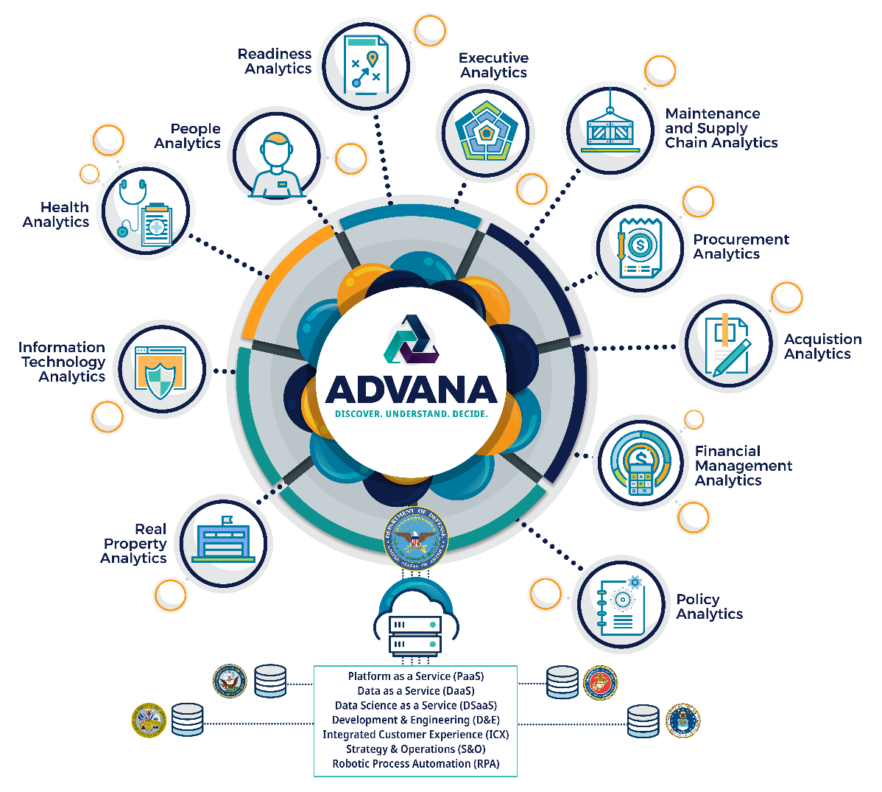
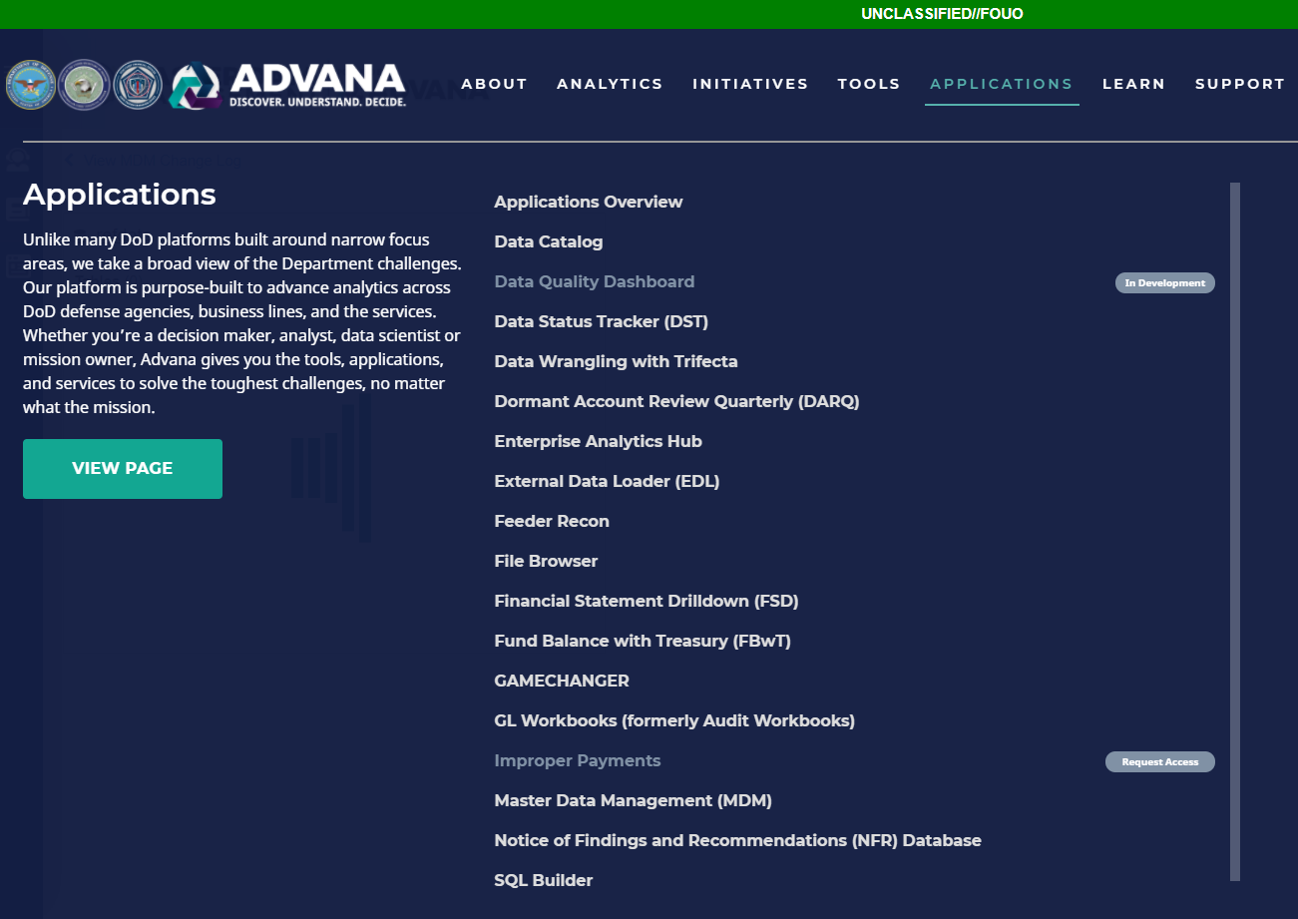
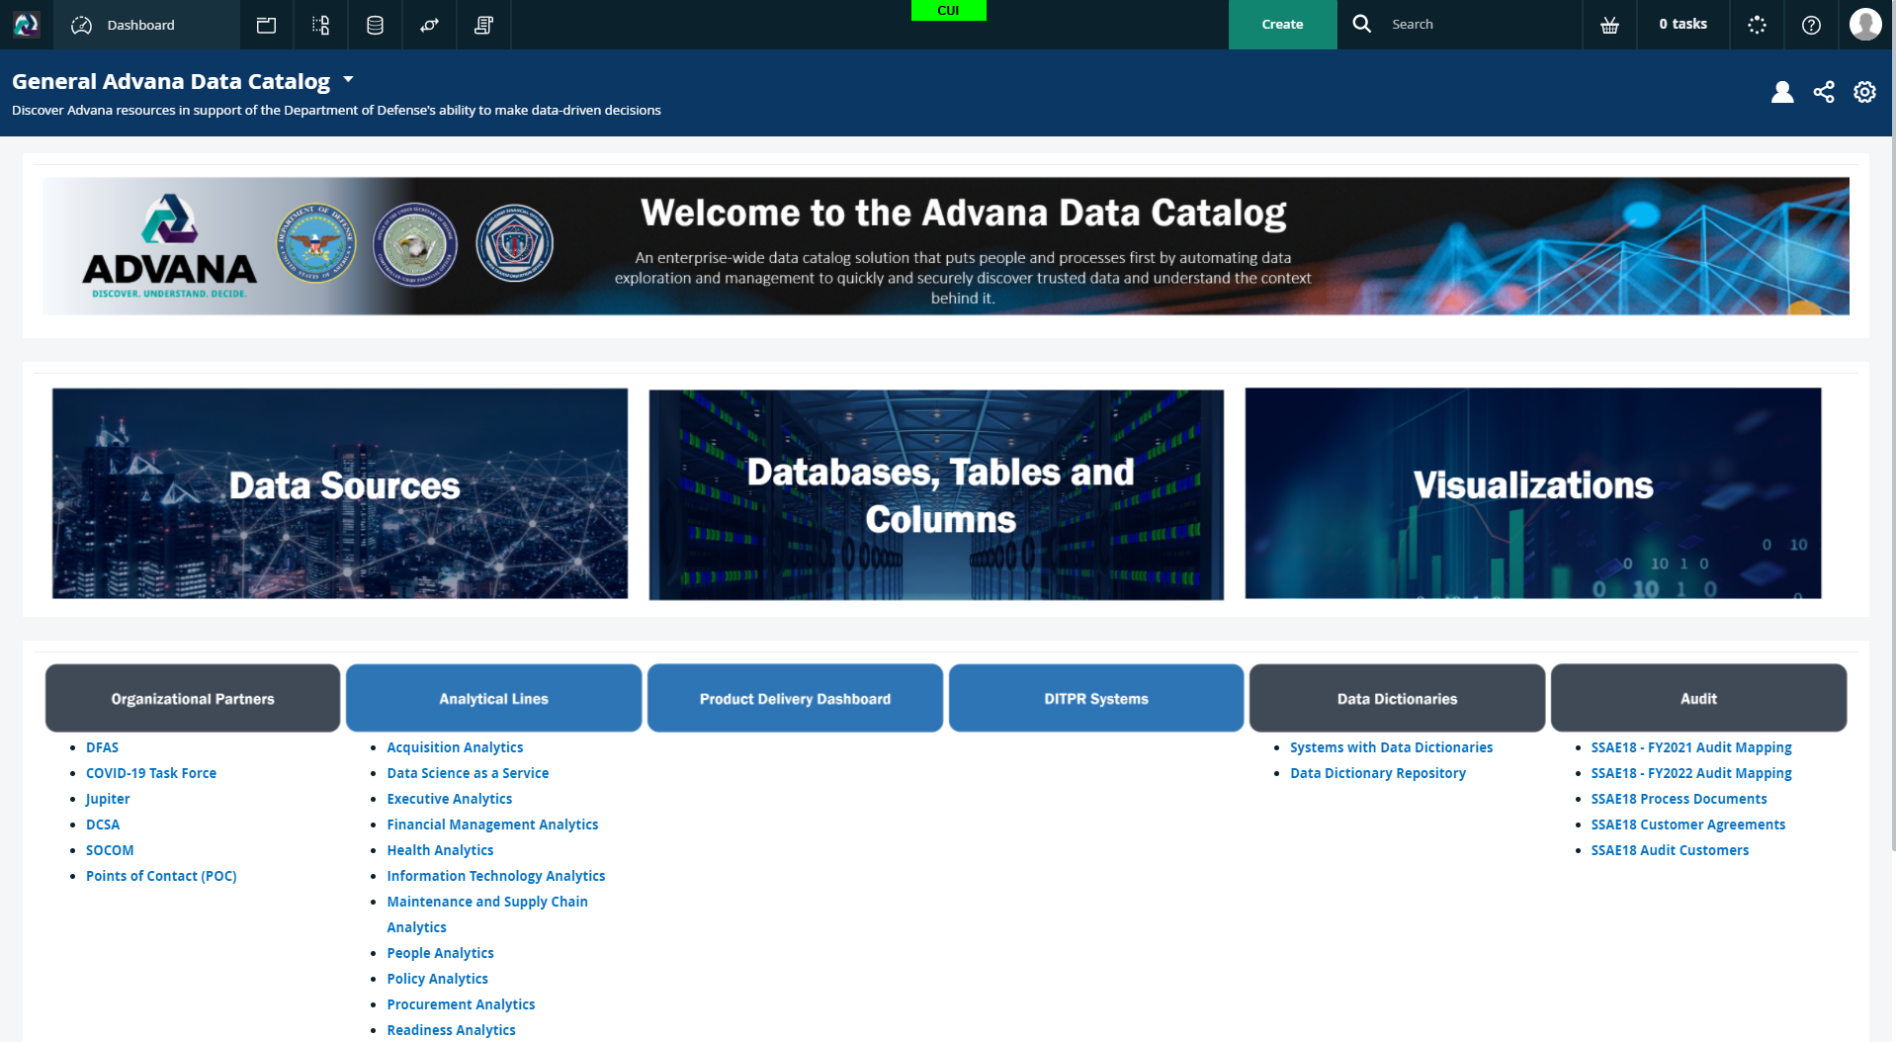
Advana’s Existing Applications and Tools

Slide 4





Advana Financial Management Analytics
Problem Statement, Mission, and Vision
Advana Financial Management Lead:
Kate Sieve
Advana Financial Management Mission Improvement Lead:
Brenna Klein
Problem Statement:
DoD has not been able to achieve auditability in 30 years, since mandated by the CFO act of 1990. This is a direct result of DoD's inability to produce a complete Universe of Transactions validated to the Department’s financial statements. Business feeder systems and accounting data alone are not useful for leaders to make decisions because they are not holistic, timely, or consistently accurate.
Where were we a year ago:
Several products were live and used by single customers. Several initiatives were still in pilot phases with plans to expand and take over existing systems but were generally still operating in parallel. Audit portfolio still had not passed an SSAE-18 audit.
Mission:
Resolve some of DoD’s largest financial statement audit, budgetary reporting and cost management challenges with tools that are purpose-built to drive audit success and support timely, data-driven decision making across the Department. Develop and maintain audit products that enable the Department’s progress toward better financial management and a clean opinion.
Where we are now:
Several products are now used to support customer audits (Navy workbooks, FBWT data, FSD). Improper Payments has replaced BAM as the DFAS Enterprise Improper Pay identification tool and prevented over $11B of Improper Payments. Advana is now the source for the JV One-Pager. UOT support to customers has expanded to DSCA SAA and the USAF. Program Budget is now using a custom spend plan tool collaboratively built by the Advana team in under 4 months.
Vision:
Enhance the Department of Defense audit posture and financial management through the power of common enterprise data. Better serve the warfighter and address National Defense challenges by making data widely accessible and understandable, and developing analytics to promote informed decision making, better align resources and make smarter investments.

Slide 5
Air Force Universe of Transactions
General Ledger to Unadjusted Trial Balance Reconciliations

Slide 6
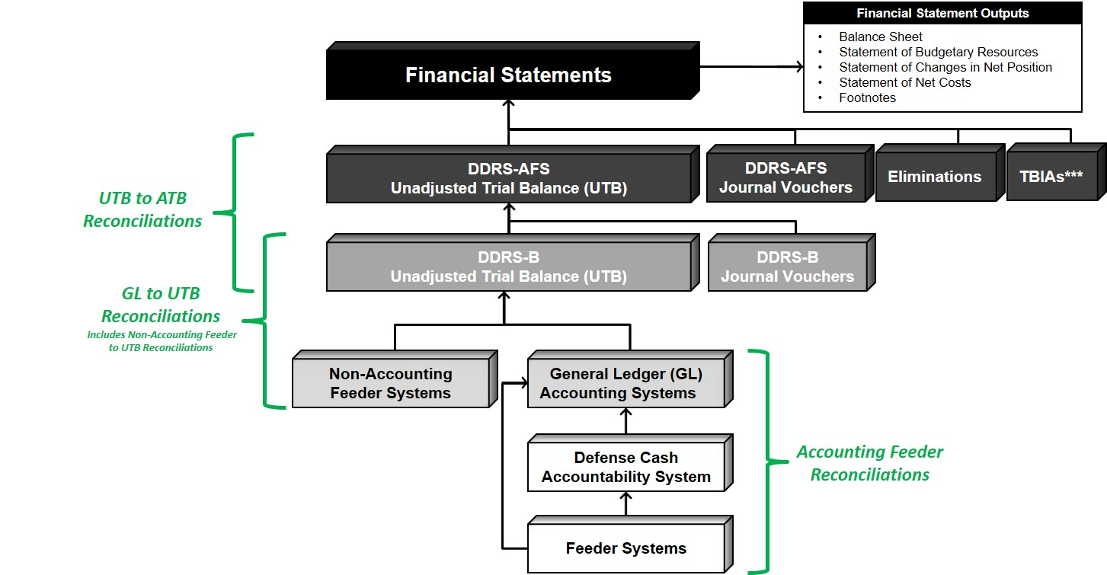
Air Force Universe of Transactions (UoT)
In March 2021, OUSD(C) EDBP and SAF-FM initiated the build of an Air Force UoT on Advana. The project team is currently focused on acquiring and reconciling Air Force’s general ledger details. The UoT roadmap also includes milestones for acquiring and reconciling Air Force’s accounting feeder data and trial balances, among other tasks. Specifics regarding the scope of these reconciliations are detailed below.
Financial Statement Compilation and Reporting Flow
Accounting Feeder System (e.g., entitlement, disbursing, and other types of financial and non-financial systems) and Defense Cash Accountability System (DCAS) data is reconciled to General Ledger details.
General Ledger details are reconciled to the raw Unadjusted Trial Balances the General Ledger system owners submit to the Defense Departmental Reporting System’s Budgetary Module (DDRS-B).
  Note: Advana produces these reconciliations monthly for Navy to support one of their recurring PBC commitments.
DDRS-B processed Unadjusted Trial Balances are reconciled to Adjusted Trial Balances sourced from the DDRS Audited Financial Statements Module (DDRS-AFS).
1
3
2
2
1
3
***TBIA stands for Trial Balance Input Adjustment

Slide 7
Dormant Account Review - Quarterly

Slide 8
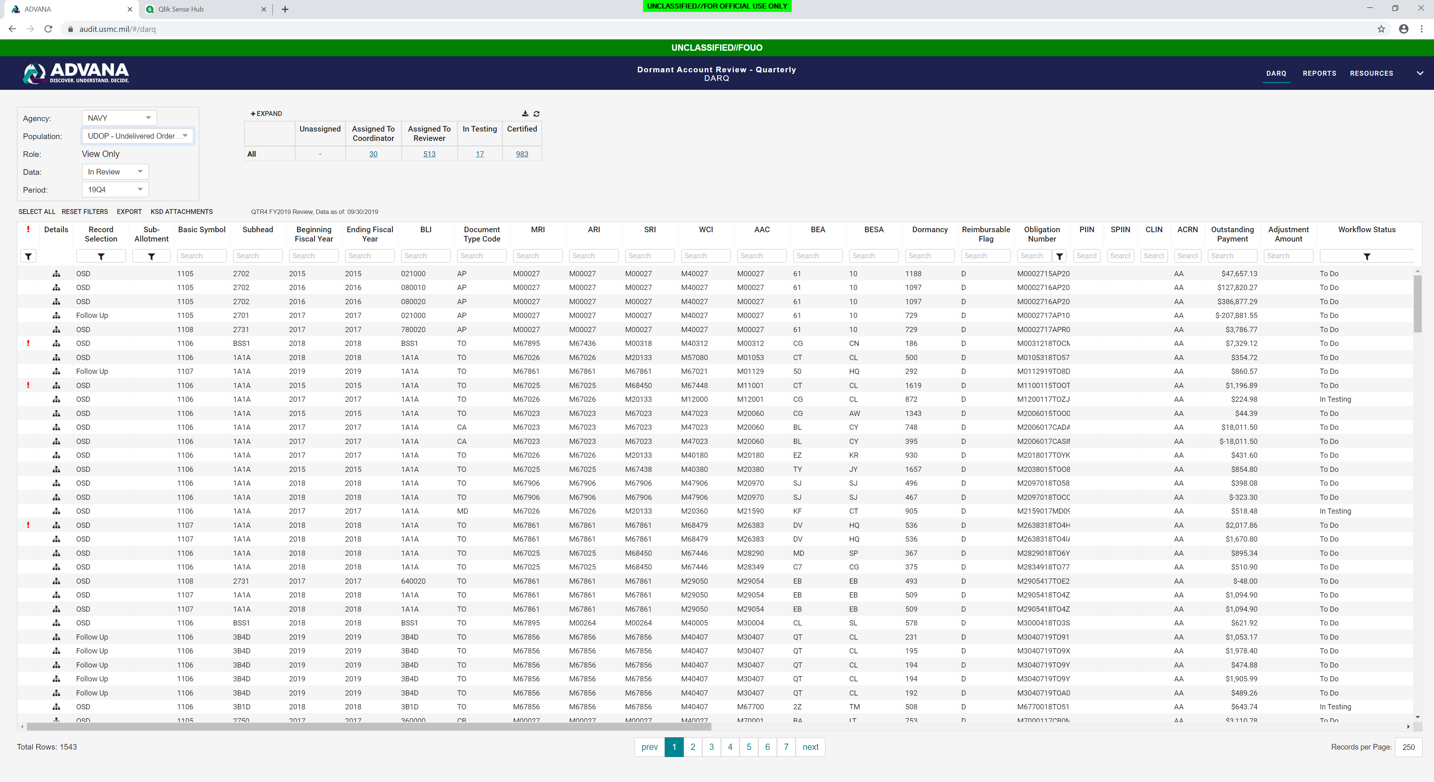
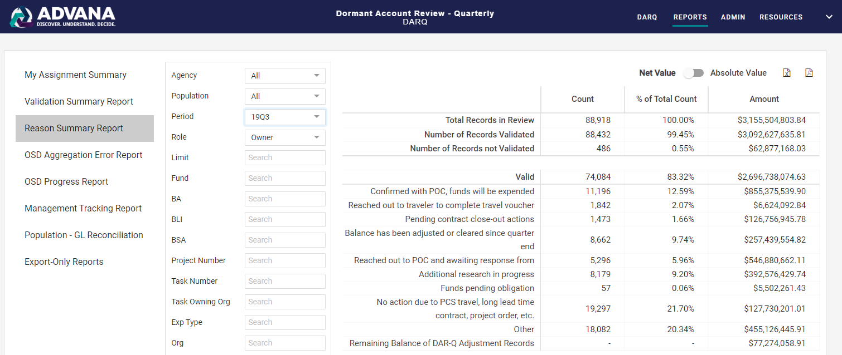
Dormant Account Review - Quarterly
Web Application to support the FMR required Dormant Account Review – Quarterly (DAR-Q) of dormant, unliquidated Obligations (ULOs) and Unfilled Customer Orders (UFCOs)
Before DAR-Q and the Advana DAR-Q Tool:
OUSD(C) and Entities received NFRs on the Tri-Annual Review (TAR) process
Inconsistent application and nonstandard submissions of the TAR across DoD
Multiple “data calls” were required across assessable units, resulting in manual compilation of data and publication of reports
Benefits Because of Advana:
Replaces and automates the DAR-Q for 24 4th Estate Agencies, Joint Staff, half of the Navy, Army, and SOCOM
DAR-Q populations are generated from Advana, the OUSD(C) Universe of Transactions that is provided to Auditors
Automated population generation and workflow eliminates inefficiencies experienced across the DoD, providing more time for Entities to conduct a valuable review and reallocate dormant funds
Prioritizes the review of high-value, dormant balances at risk of Expiring or Canceling, and provides a centralized repository for the management and tracking of these balances
FY 2021 Q1
FY 2021 Q2
FY 2021 Q3
FY 2021 Q4
Entities | 27 Total Agencies | 28 Total Agencies | 28 Total Agencies | 28 Total Agencies
Users | 10,000+ | 13,000+ | 14,000+ | 17,000+
Count of Funding Documents Reviewed | 156,110 | 192,215 | 417,851 | 276,508
Absolute Value of Funding Documents Reviewed | $6.8B | $7.5B | $8.8B | $16B
Sum of Funding Adjusted/Cleared | $1.09B | $1.33B | $2.04B | $1.85B
IMPACT: The “Sum of Funding Adjusted/Cleared” shows the amount of funds that were cleared or adjusted as a direct result of DAR-Q each QTR; allowing for a total of $6.3B in the past year of dormant, high-risk funds to be adjusted and reprioritized for better uses prior to the funds expiration or cancellation.

Slide 9
Financial Statement Drilldown

Slide 10
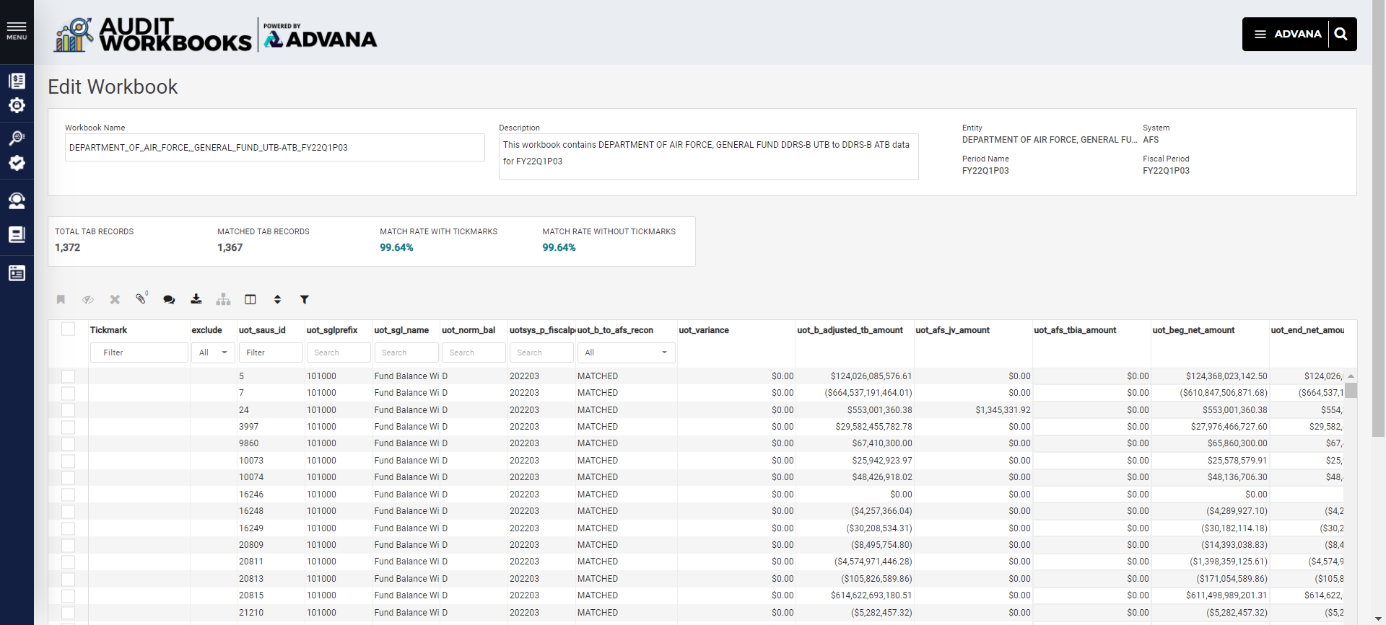
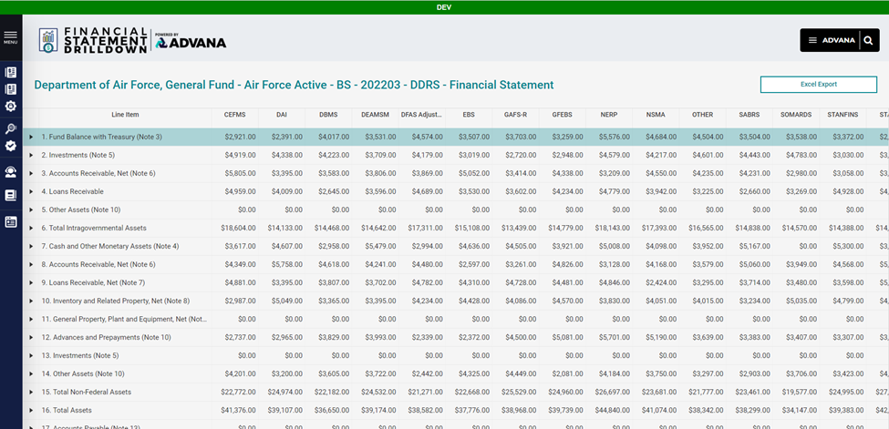
Financial Statement Drilldown
Product Demo #1:
DDRS-B to DDRS-AFS Reconciliation (known as UTB/ATB)
Benefit:
Helps DoD FM Users quickly identify any discrepancies between DDRS-B and AFS and process any needed adjustments
Product Demo #2:
DDRS-AFS Financial Statements
Benefit:
Helps DoD FM Users view a drill-down from financial statements to USSGL detailed transactions by feeder systems.

Slide 11
Financial Management Analytics
Executive Dashboard

Slide 12
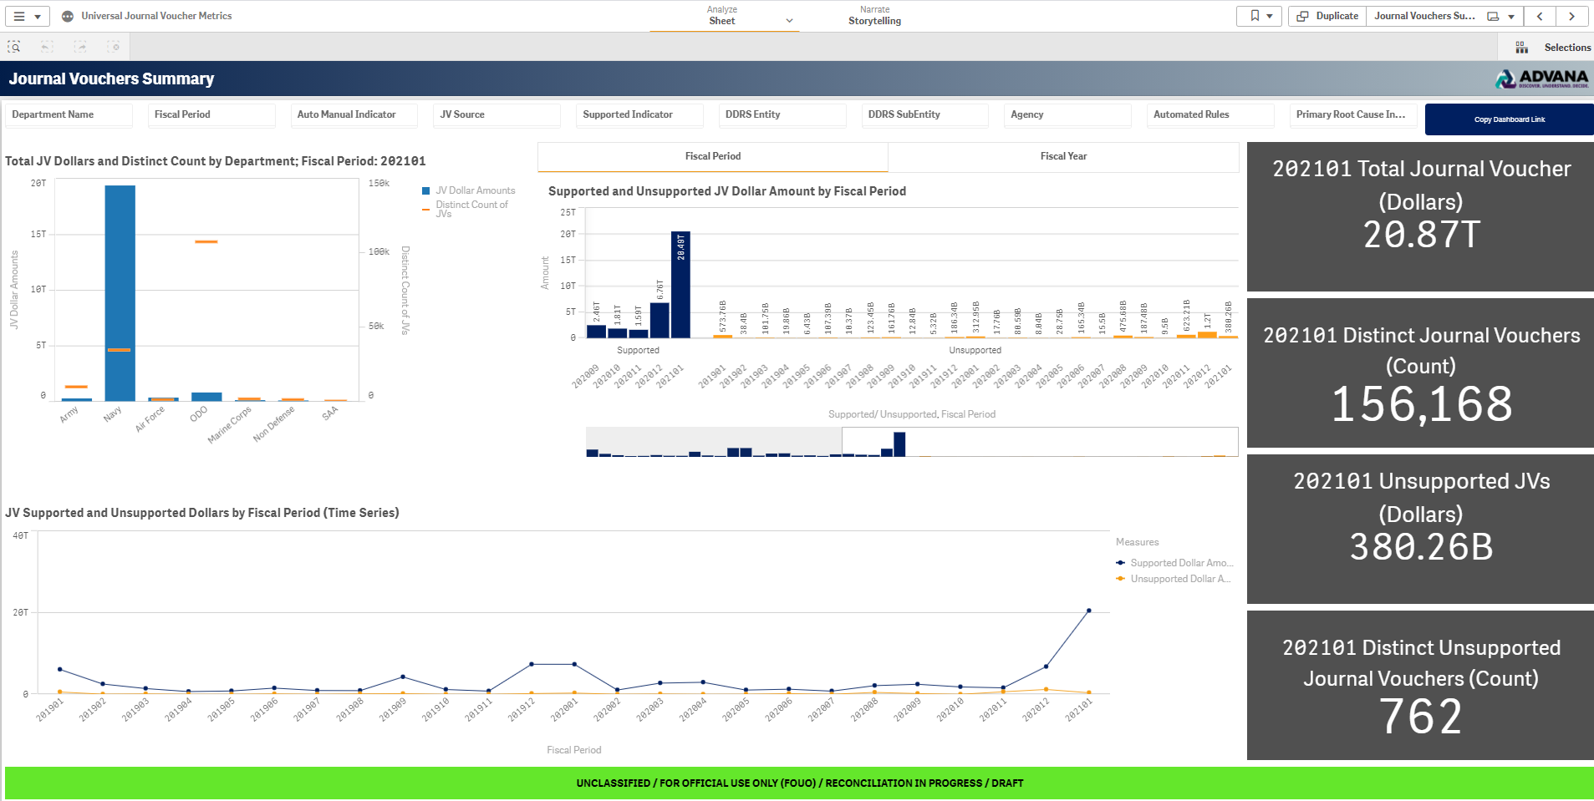
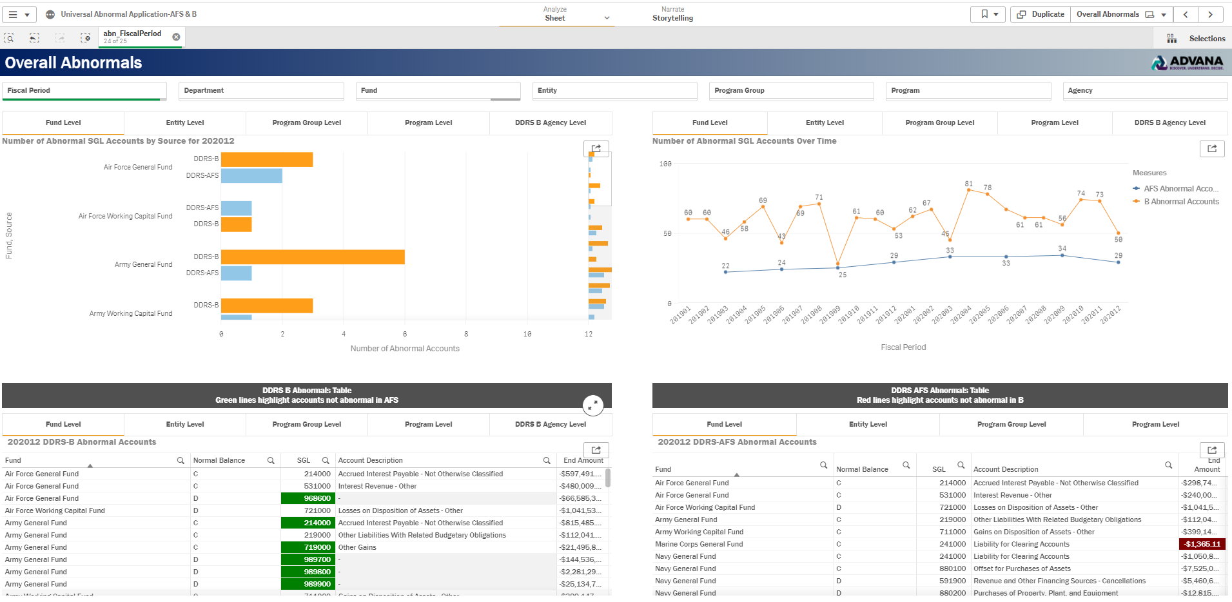
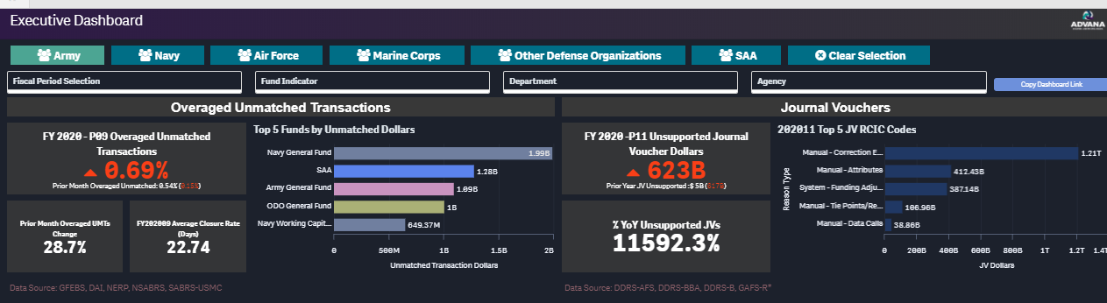
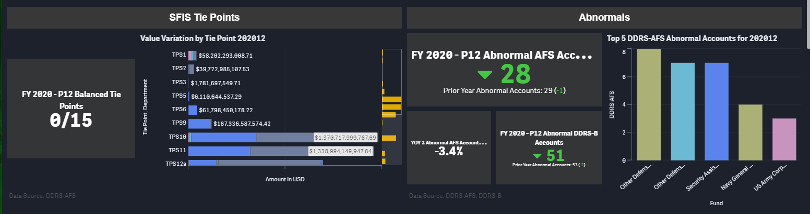
Financial Management Analytics Executive Dashboard
Executive view of key Leadership FM ‘Health’ Metrics
Supporting applications for each metric with drilldown details to support metrics by transactions
Before Advana:
Metrics were calculated locally and provided in spreadsheets without supporting detail or consensus on the calculation methodology.
Exploring performance across systems meant logging into each system and consulting with a subject matter expert on that particular system.
Benefits Because of Advana:
Metric performance and supporting detail is all available in single location, providing both the executive view against KPIs and the ability to drill into individual transactions that comprise the metric.
OSD Comptroller has available information and insight needed to ask the correct questions to provide effective oversight of the enterprise FM performance.
The Executive Dashboard currently includes 11 metrics, each with a drill-down page and separate application providing full transactional detail.
Provides functionality to filter down to an individual service or agency in order to provide metrics tailored to the specific user.
IMPACT: The FM Executive Dashboard provides Comptroller with transparent and timely metrics in order effectively provide oversight to the department. Ability to drill into transactional data facilitates root cause analysis for analysts and provides FM Executives needed context to prioritize remediation and corrective action activities.

Slide 13
Resources

Slide 14
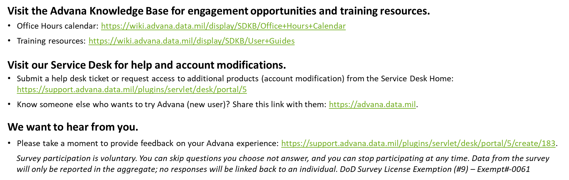
Resources
Reach out to learn more
Kathryn Sieve (kathryn.s.sieve.civ@mail.mil), Financial Management Analytics Lead
Scott Miller (scott.r.miller121.ctr@mail.mil), Air Force UoT Product Lead
Brenna Klein (brenna.m.klein.civ@mail.mil), DARQ Product Owner
Nicholas Crabtree (nicholas.d.crabtree.civ@mail.mil), Financial Statement Drilldown Product Owner
Torey Holderith (torey.b.holderith.ctr@mail.mil), Financial Management Executive Dashboard Lead

